Slide 1
Parliament’s official documents
EP document models, DocEP, Translation workflows
DIRECTORATE-GENERAL FOR TRANSLATION – Information Technology & IT Support Unit

Slide 2

Ep iNFORMATION – Europarl website
Powers and procedures
Organisation and rules
Rules of Procedure

Slide 3
Set list
I. EP document models
II. DocEP documents
III. Translation workflows
IV. DocEP installation and use

Slide 4
I. EP Document models

Slide 5
The ‘recueil de modèles’ (rdm)
Who
Plenary services, parliamentary committees, translation, IT
Chaired by the Directorate of Legislative Acts
What
Model needed?
Standard wording
Rules on presentation

Slide 6
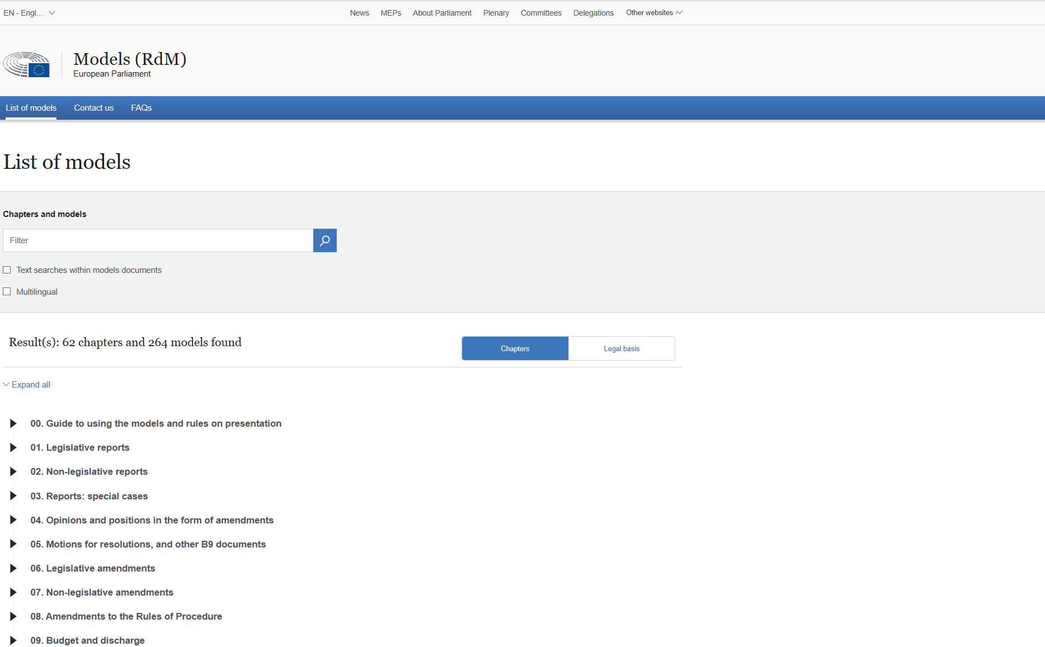
The ‘Recueil de modèles’ (rdm)
RdM website

Slide 7
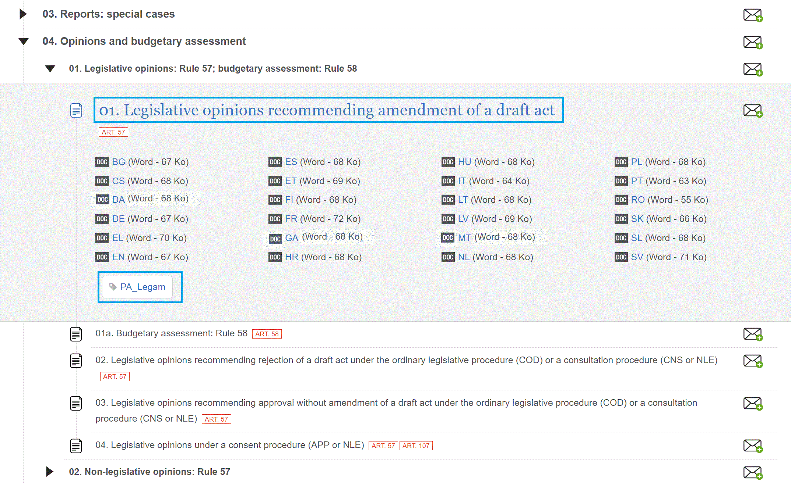

Slide 8
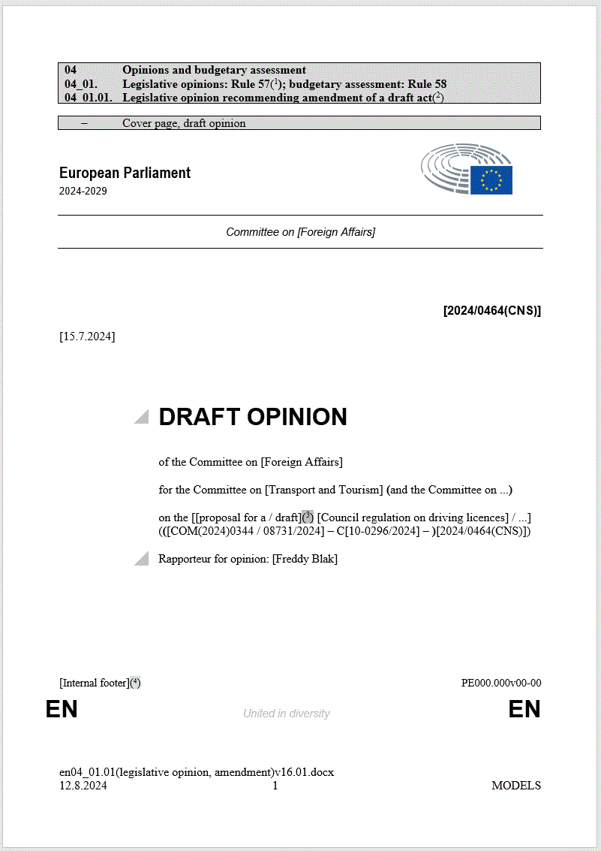
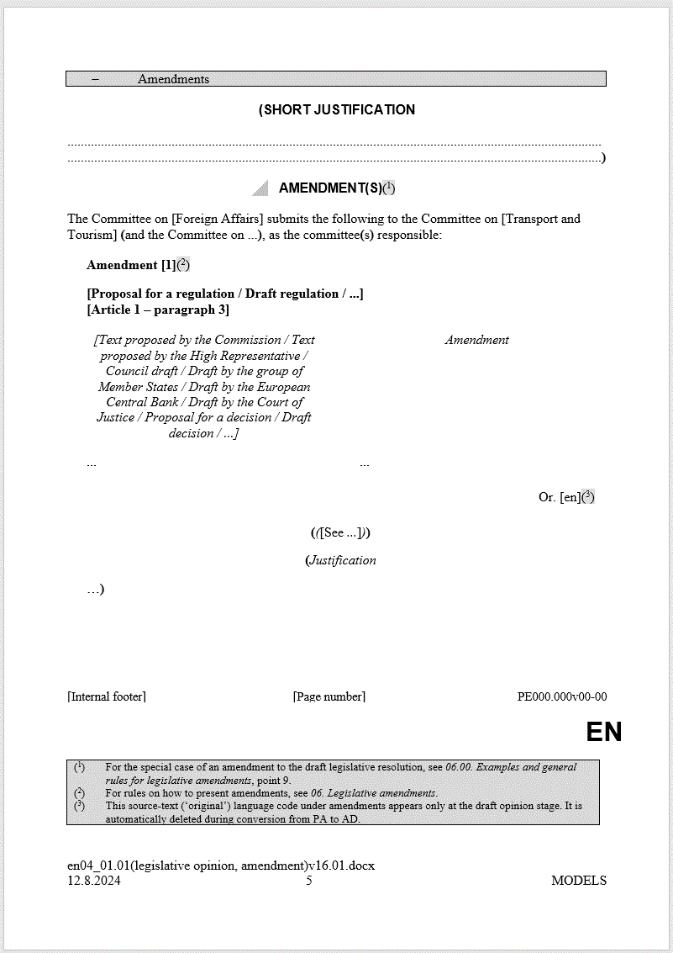

Slide 9
II. DOCEP Documents

Slide 10
Docep
Is an MS Word Add-in
Creates documents using the standard wording and presentation of the official RdM models
Adds the necessary tags, codes, styles and properties, which are used for publication of the documents
    in the Public Register (generation of a bibliographical note)
    on Europarl (conversion into xml by Europarl services)

Slide 11
DocEP Documents
Visible elements
(from the models)
Standard wording
Presentation
Hidden elements
(not in the models)
Tags
Codes
Styles
Document properties

Slide 12
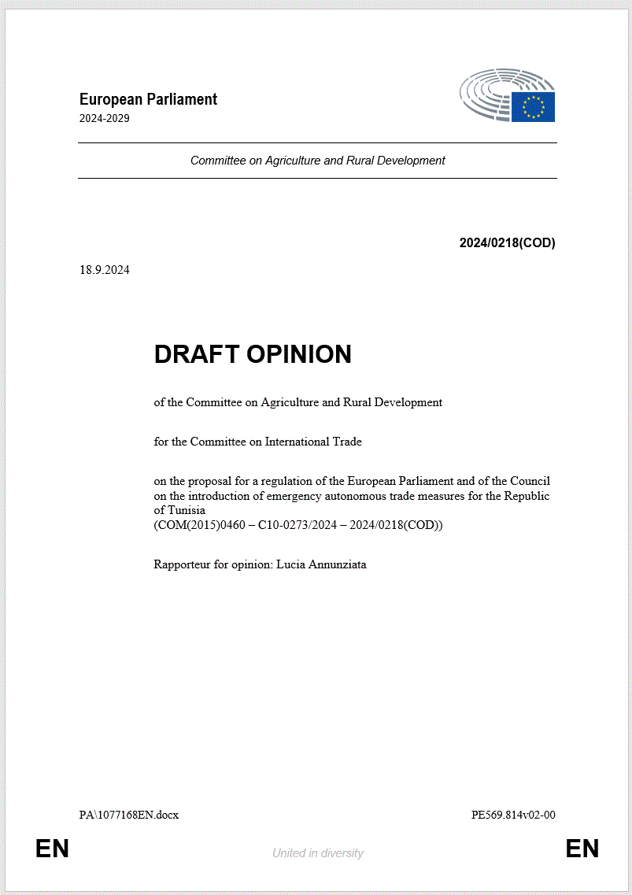

Slide 13
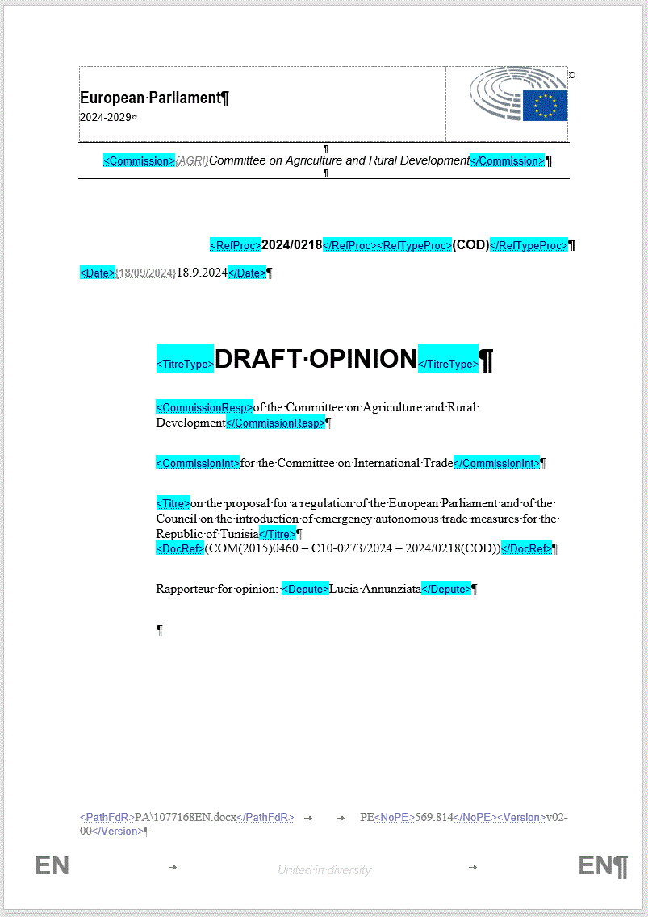

Slide 14
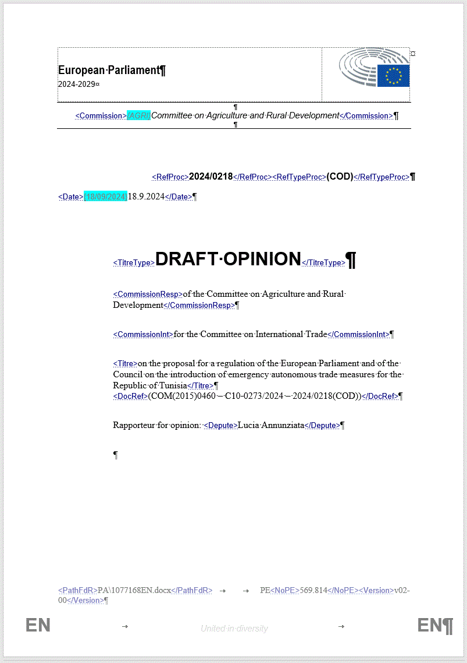

Slide 15
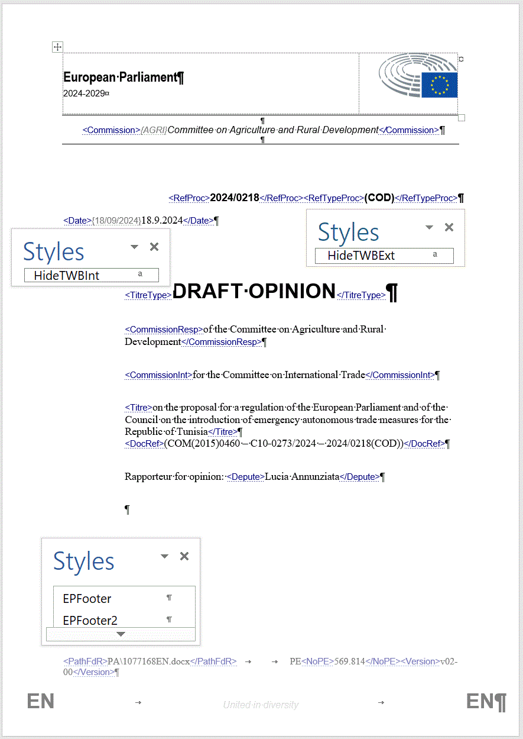
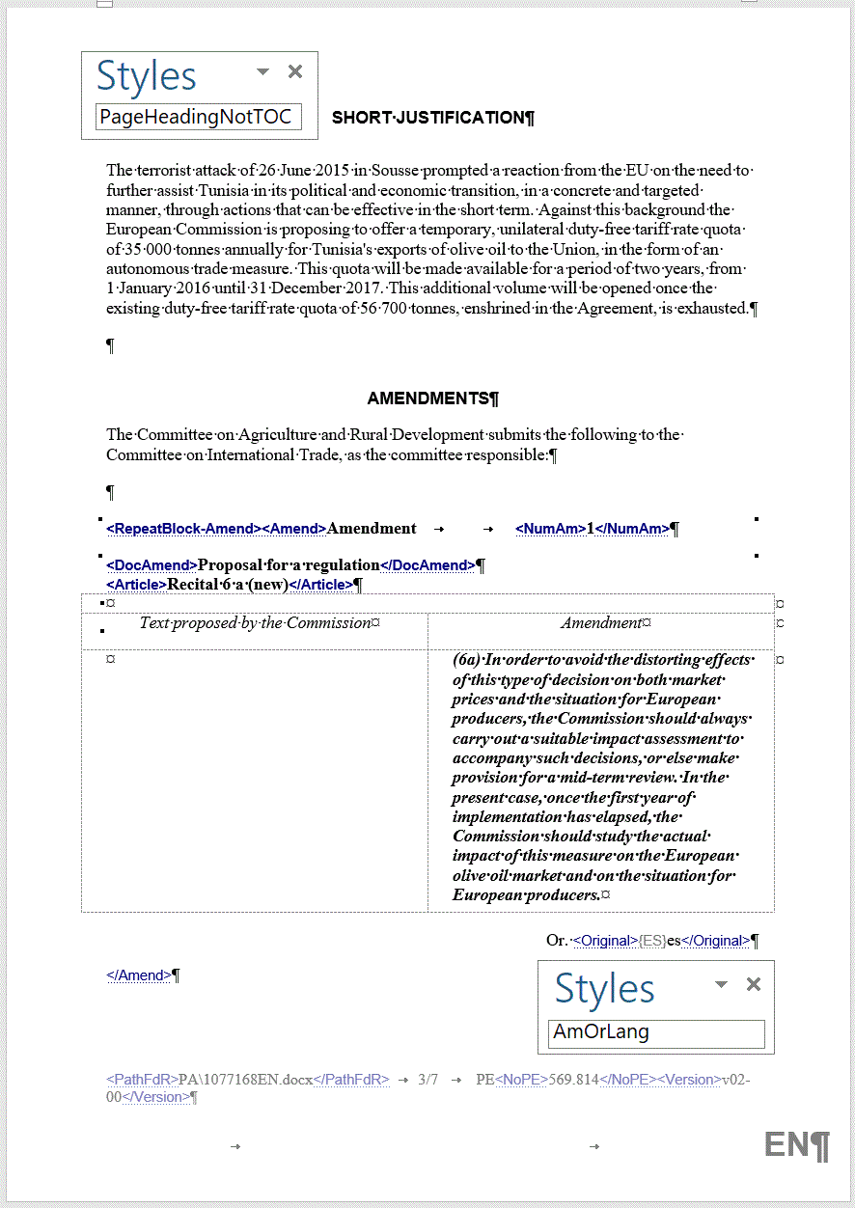

Slide 16
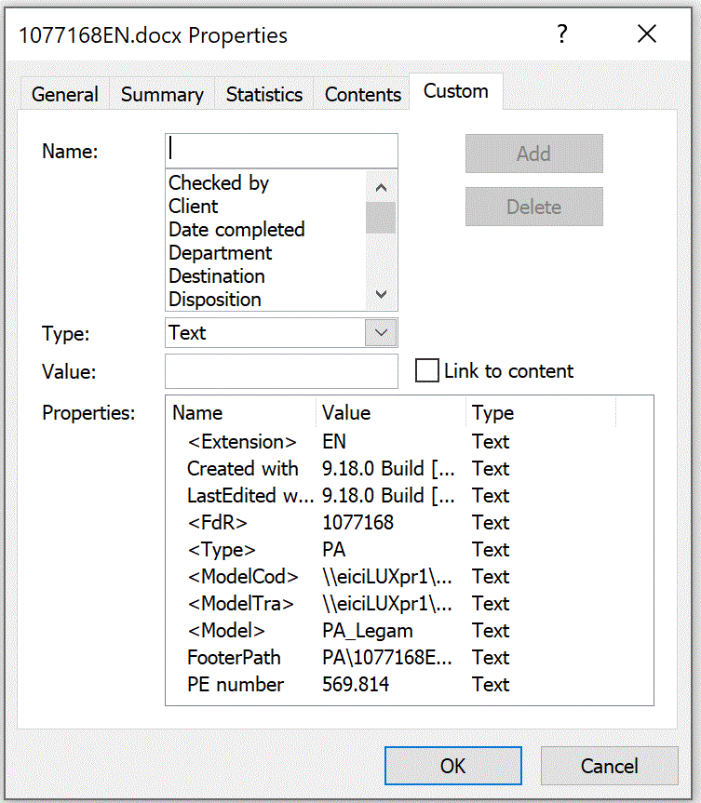
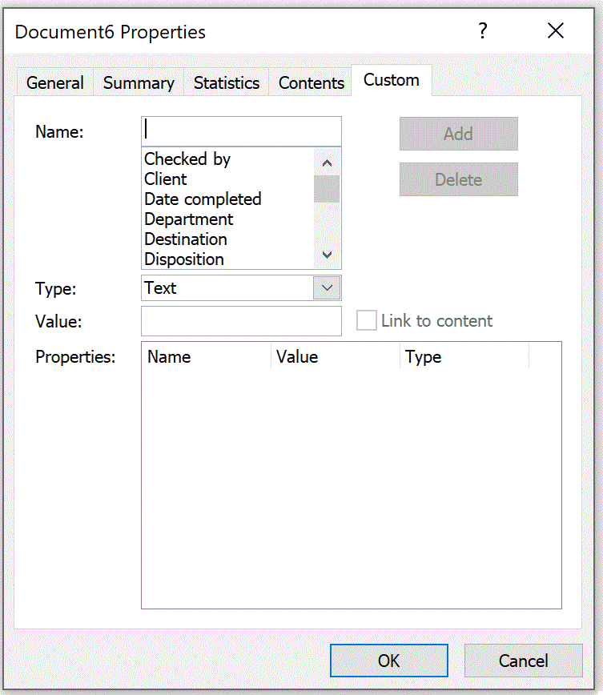

Slide 17
III. Translation workflows

Slide 18
Requirements for translated documents
Wording and presentation must comply with the official RdM models
Tagging, codes, styles and document properties must be correct, in order to publish the documents on the Europarl website and in the Public Register

Slide 19
Two workflows
Normative TM/BRTM
Use the sdlxliff file from the
pre-treatment package
Use the Normative TM/BRTM to complete the translation of the standard wording, as well as the amendment headings and the left-hand column
DocEP
Create the target language (TL) document using the appropriate DocEP template
Follow the on-screen prompts to set up the standard wording
Copy non-standard content from the original
Add the document to the Studio project
Lock the segments set up with DocEP, as they are already in the TL
Use the Normative TM/BRTM to get the translation of the amendment headings and of the left-hand column

Slide 20
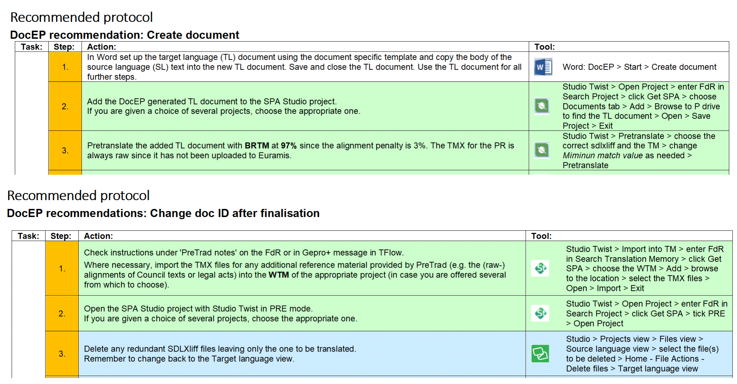
Safe working protocols – which workflow?

Slide 21
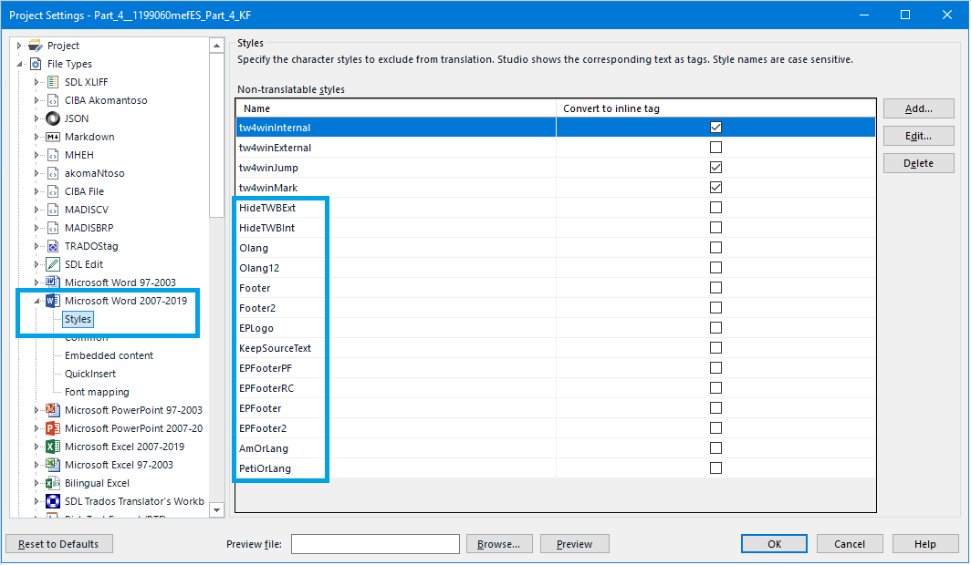
EDITOR OPTIONS - both workflows

Slide 22
KEEP DocEP PROPERTIES IN SYNC
Never copy/paste a DocEP document into a blank MS Word document
To rename a DocEP document, please use DocEP’s Change document ID function

Slide 23
Iv. Docep INSTALLATION and use

Slide 24
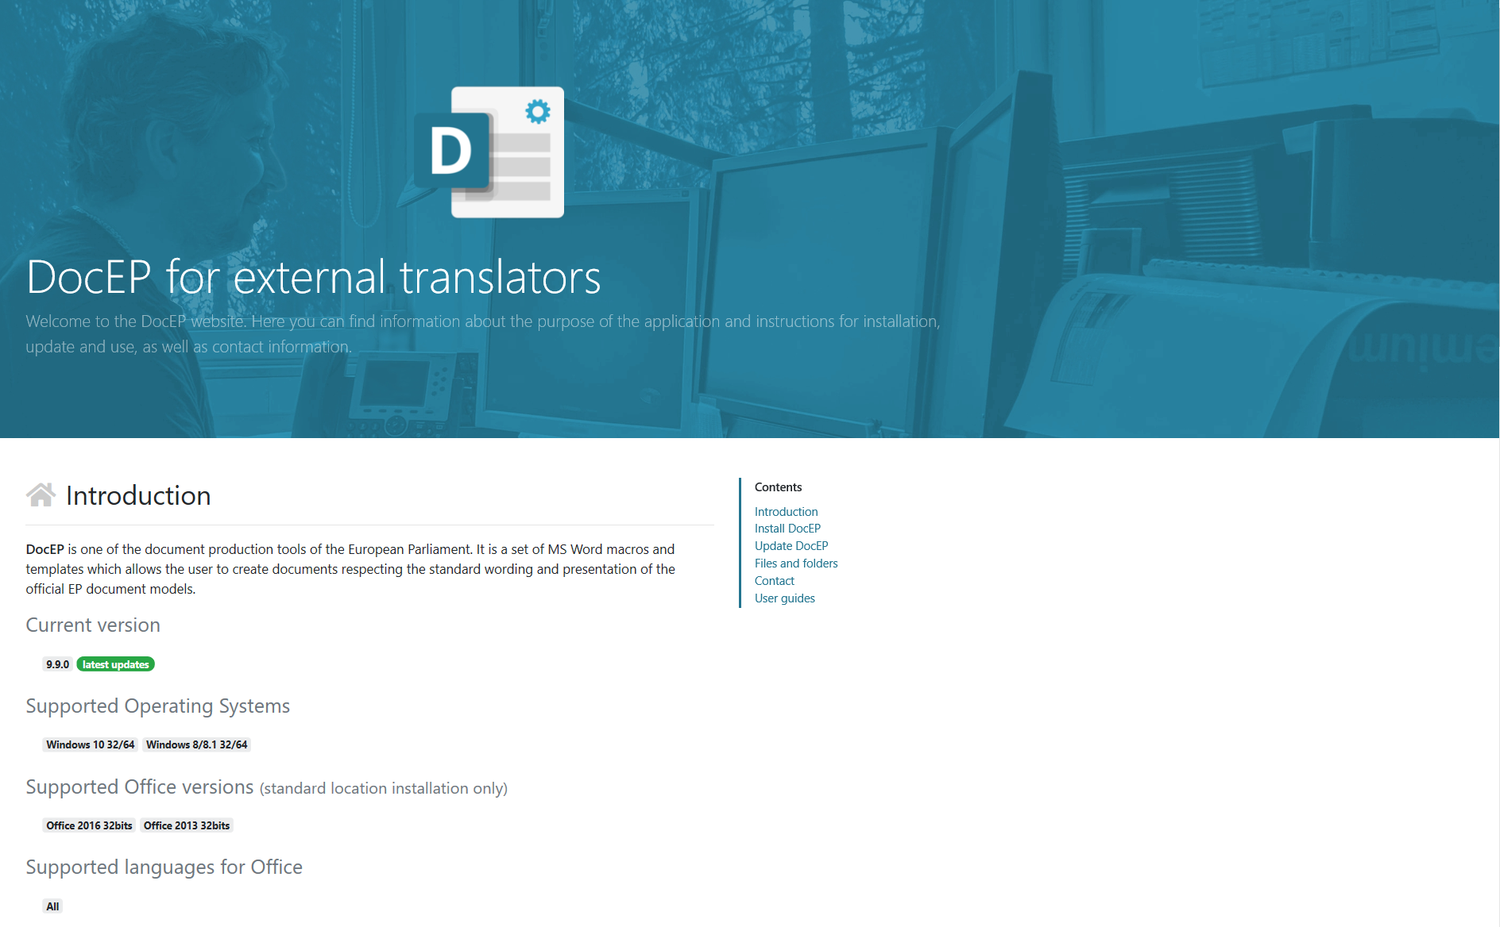
WEBSITE
Installation
Updates
User Guides

Slide 25
Docep installation & UPDATES
Download packages
Close MS Word
Run installations with administrator rights
Run updates in chronological order
A notification is sent when a new update is available

Slide 26
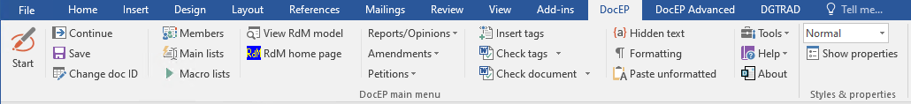
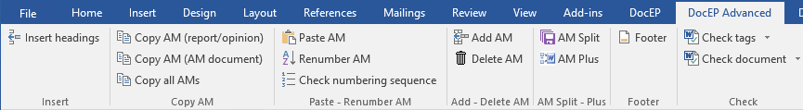
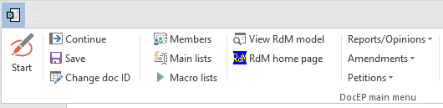
DocEP in MS Word

Slide 27
Setting up a document in Docep
Start
Fill in document type and FdR
Choose the appropriate model/template
Follow the on-screen prompts to set up standard wording
Add non-standard content
Save
Check the technical quality

Slide 28
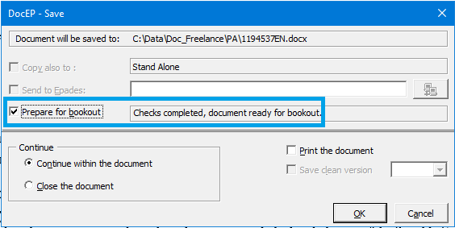
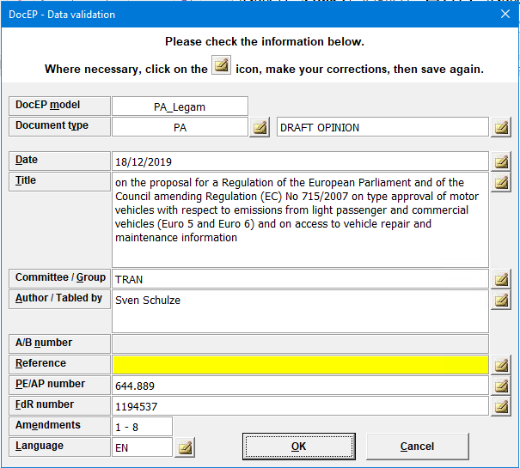
Docep Technical quality check & data validation

Slide 29
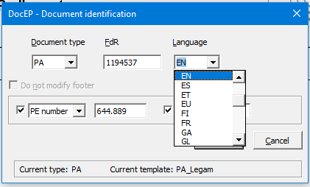
Renaming a document in Docep
Change document ID to update file name, footers and document properties

Slide 30
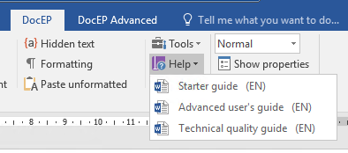
Docep User guides

