Slide 1


Terminology for External Translation

Slide 2


Outline
TermCoord’s termbases
    Content and formats
    Defined terms
    Eur-Lex
2. IATE
    What is it
    Why log on
3. Terminology and consistency
Terminology for External Translation

Slide 3
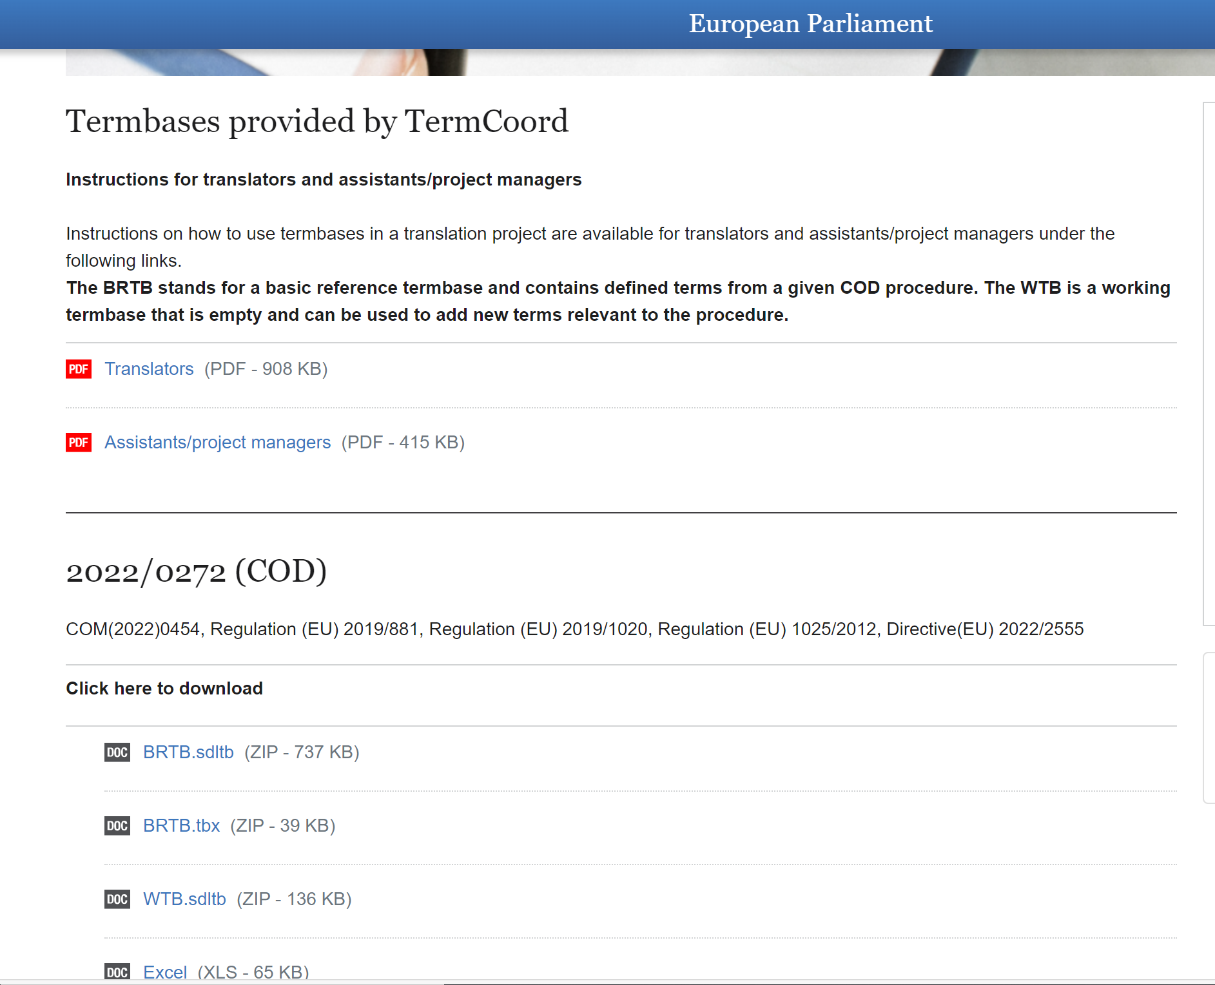

TermCoord’s termbases
FdR – field ‘Terminology Notes’:
Information on the availability of BRTB termbases for a specific COD procedure and link to the website
TermCoord’s website under development
Terminology for External Translation

Slide 4





TermCoord’s Termbases – content and formats
What our termbases contain
COD termbases created by TermCoord contain ONLY defined terms
    defined terms per procedure in 24 EU languages
The defined terms are extracted by TermCoord from EUR-Lex:
    for all Commission proposals and relevant legislative acts
    in .xlsx, .sdltb and .tbx
BASIC REFERENCE TERMBASE (BRTB)
Available on TermCoord's website
Maximum 10 MB – light footprint on Studio
Labelled accordingly: Def_terms_XXXX_XXXX_COD_BRTB
  e.g. Def_terms_2022_0162_COD_BRTB
Terminology for External Translation

Slide 5
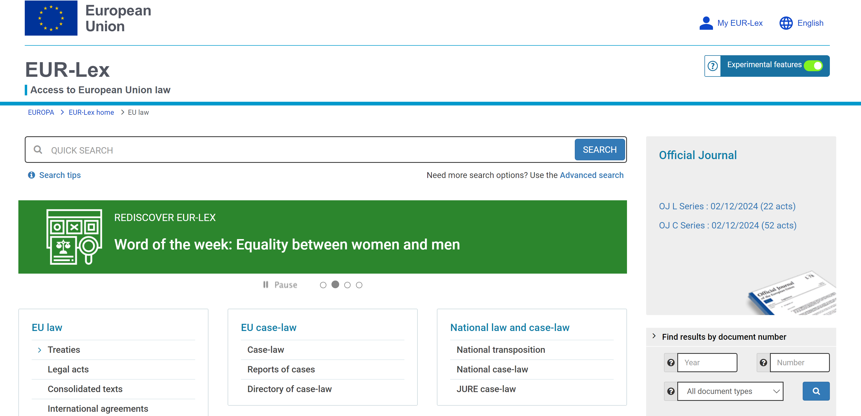
EUR-Lex

Slide 6


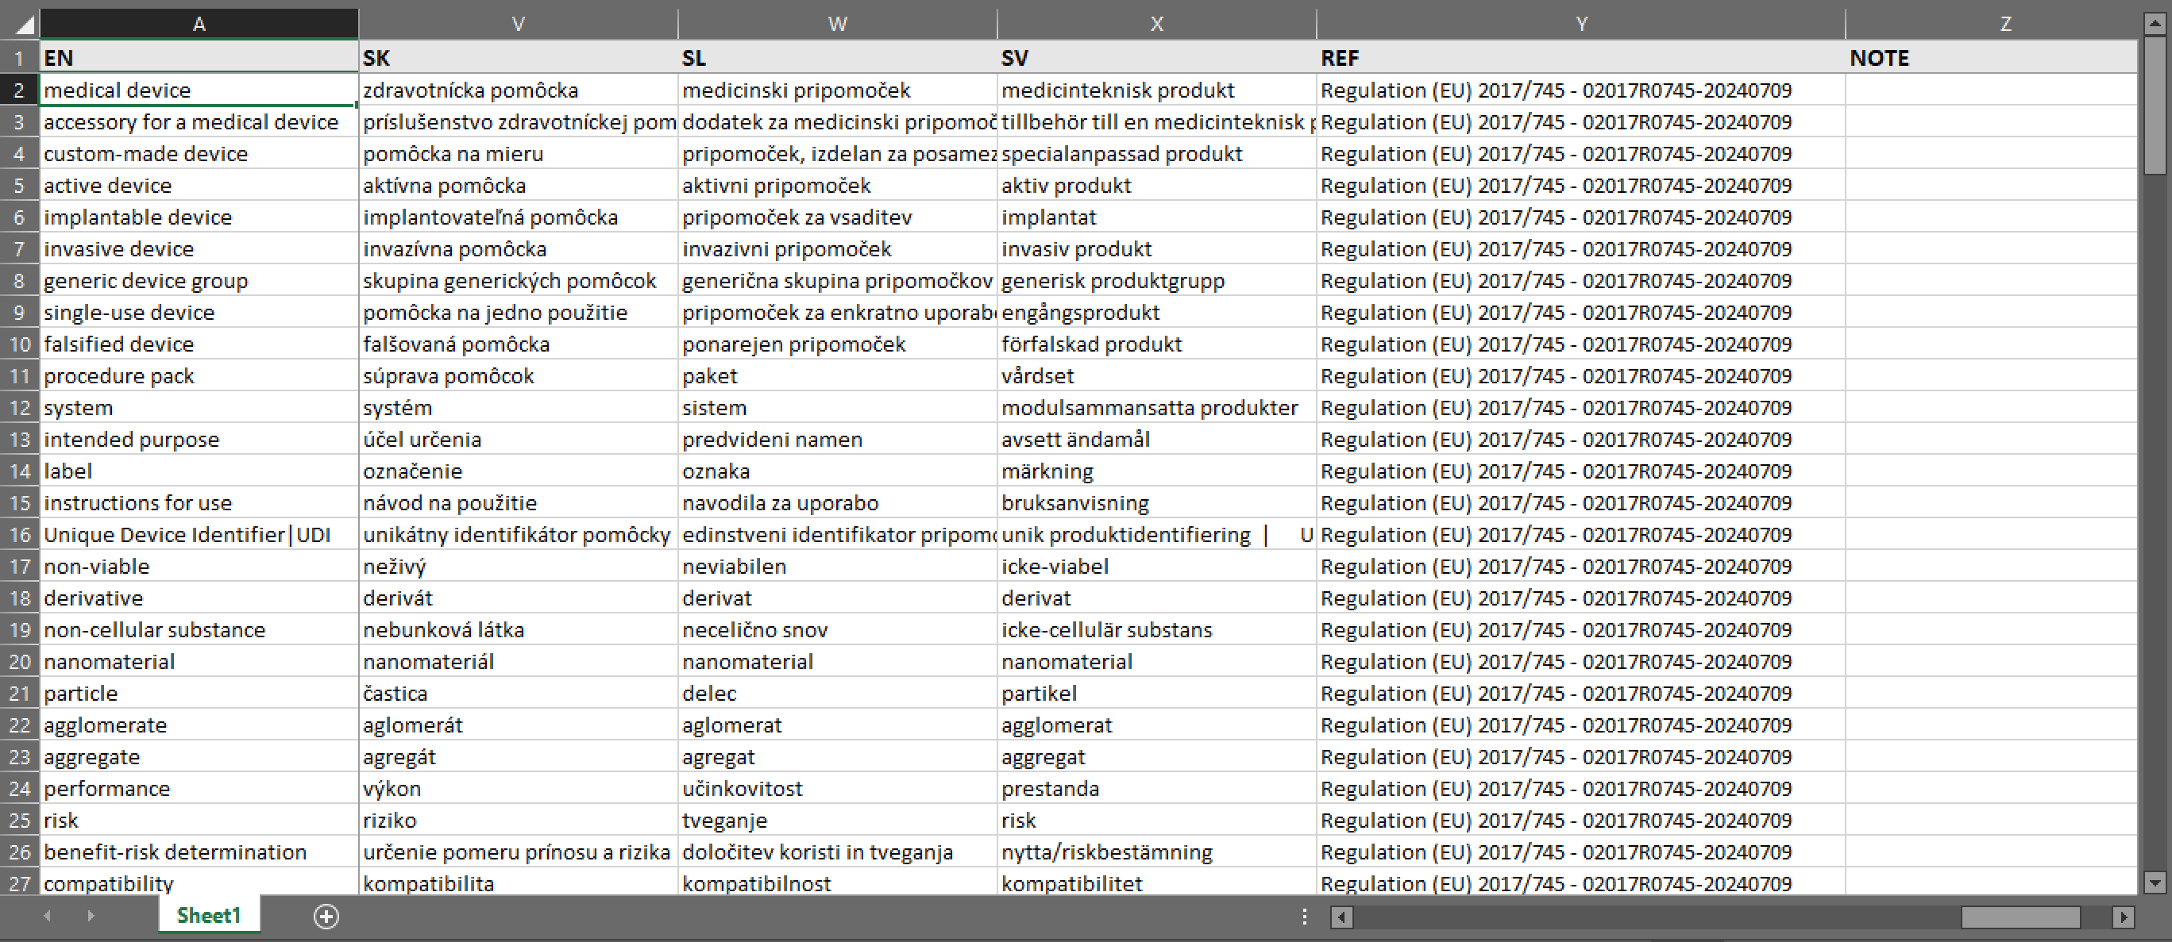
TermCoord’s termbases – the look inside
Defined terms
Reference - CELEX
Note
TermCoord prepares the multilingual XLS file with defined terms and creates the BRTB
Terminology for External Translation

Slide 7
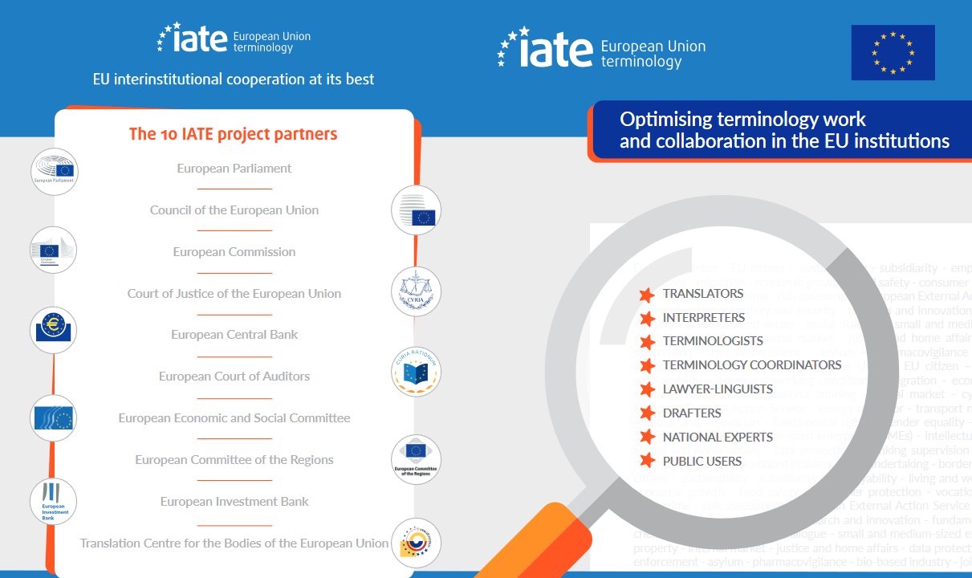
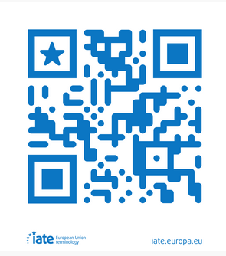
IATE
“Interactive Terminology for Europe”: EU's terminology management system
IATE - Search (europa.eu)
Terminology for External Translation

Slide 8
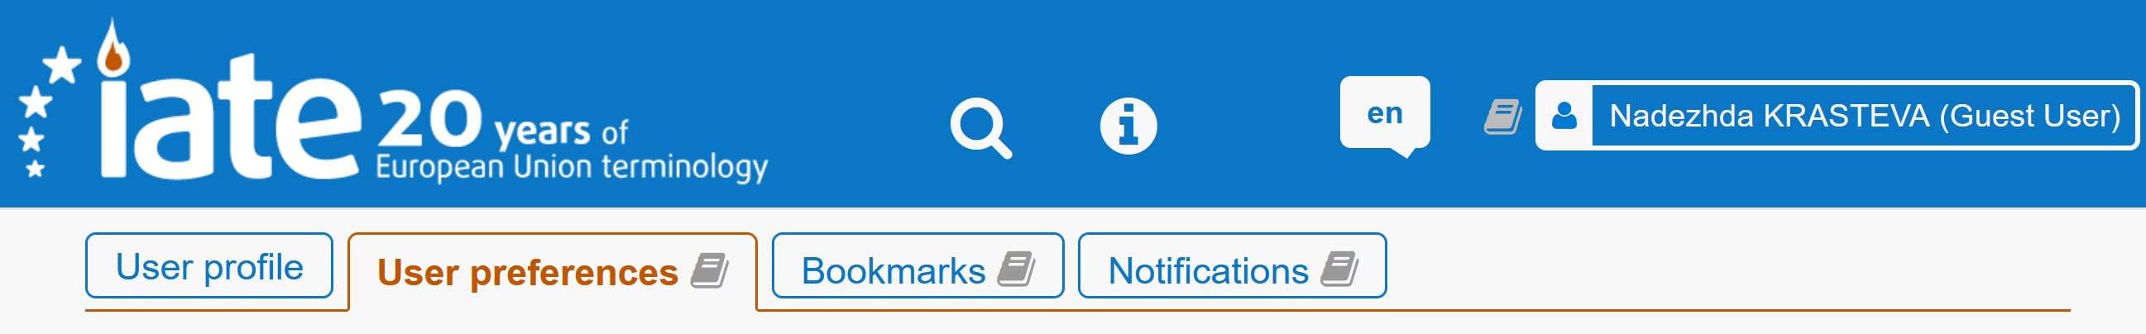
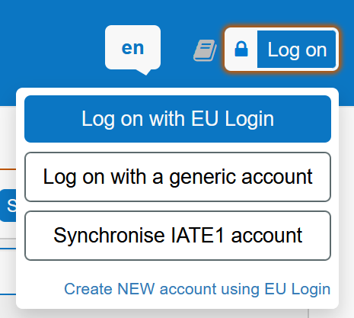
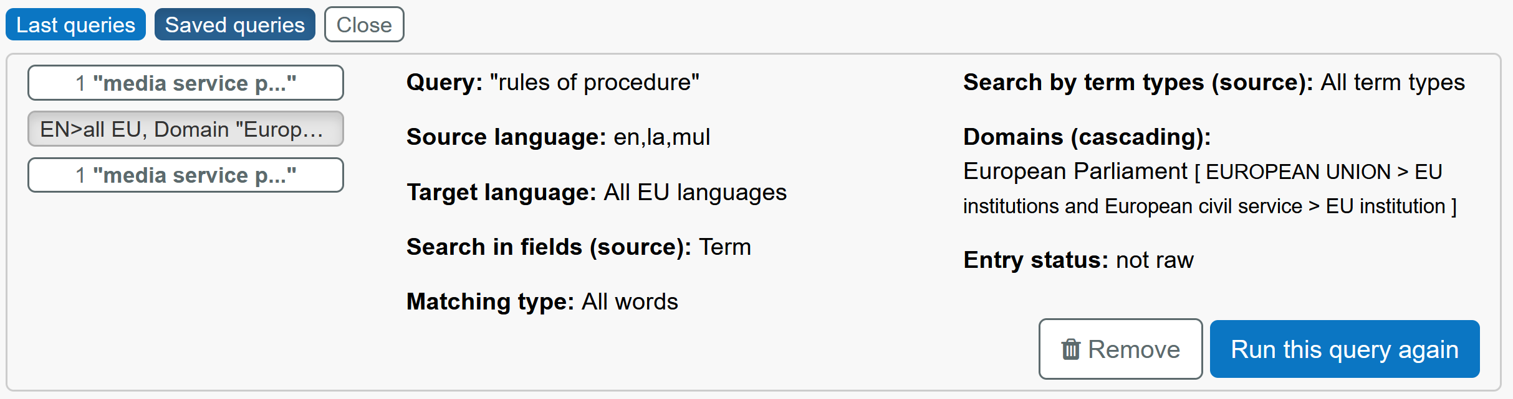
  IATE – WHY LOG ON
Save your preferences
Save your queries (in case you have applied filters you wish to save)
Terminology for External Translation

Slide 9
Terminology in the translation process
Quality of all documents translated by and for the EP
External and internal translators are given access to the same terminology resources
Clarity
Consistency
Terminology for External Translation

Slide 10



Thank you!
DG TRAD Terminology Coordination
Send your question
Terminology for External Translation

