Slide 1
QUALITY, PENALTIES AND INVOICES
Presentation for T8/2024/EU tenderers
3 December 2024
Angelika Vaasa
Quality Coordination Unit
DG Translation
Richard Dobiáš
External Translation Unit
DG Translation

Slide 2
  Every external translation is evaluated
  against quality requirements
  based on a sample
  based on xliff-file(s)
  using common evaluation methodology

Slide 3
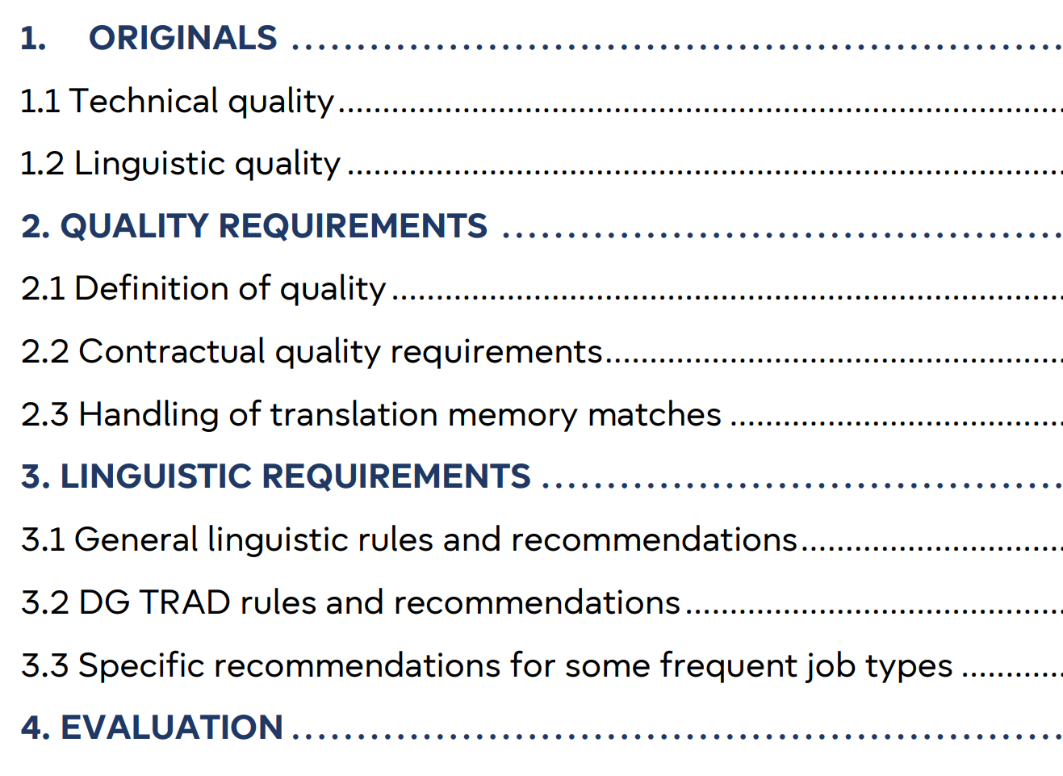

Evaluation of translation assignments – video
Calculation of the quality mark

Slide 4
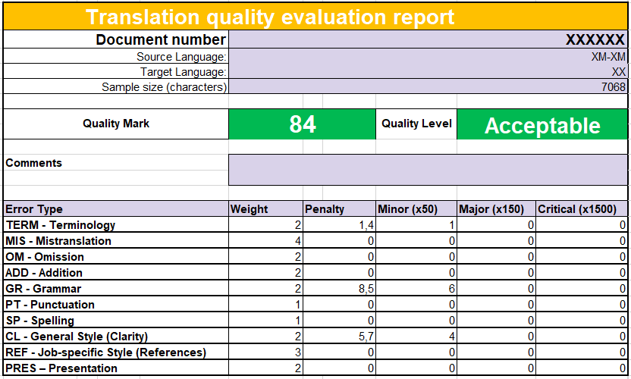
EVALUATION REPORT

Slide 5

QUALITY MARK
Formula based on sample size + error weighting + error severity → QUALITY MARK (0-100)
Acceptable (full payment)
≥ 60 points
Unsatisfactory (50% payment)
30 < 60 points
Unacceptable (no payment)
< 30 points

Slide 6
  Request for additional information
Fill in a form available on External Translation Platform
Send it within 5 working days
DG TRAD answers in 7 working days

Slide 7

PENALTIES (1)
  Unjustified refusal: EUR 500/assignment
  Minimum capacity
  Refer to Article I.6(8) of your contract
  How to refuse – Instructions for main/secondary

Slide 8
PENALTIES (2)
  Quality
  Late delivery
  50% QM<60
  100% QM<30
  re-delivery: second QM prevails
  50%
  unless force majeure
  Q-LD cumulative up to 100%

Slide 9
  NEW: Late Delivery Justification
Cases of force majeure – Article II.16 of your contract
Fill in a form available on External Translation Platform
Send it asap, by 48 hours
If justified, no penalty

Slide 10
INVOICES
  Forms
  E-Invoicing – Supplier Portal Guide, e-Invoicing Manual
  .pdf via E-mail
  paper

Slide 11
THANK YOU!

