Slide 1

Pre-treatment packages

Slide 2
PRETRAD – THE EURAMIS PRETRANSLATION UNIT
Horizontal (support) unit
We provide optimal conditions for translation in terms of speed, costs and consistency
We centralize routine operations and all preparatory work (➔ pre-treatment)
Pre-treatment packages that contain all the resources needed for translation (original document, translation project, translation memories, references in TMX format, instructions on how to handle documents from preparation to delivery)

Slide 3

MAIN CATEGORIES OF DOCUMENTS
MONOLINGUAL
MULTILINGUAL
1-COLUMN
1-COLUMN
containing
2-COLUMN
amendments
containing
2-COLUMN
amendments

Slide 4
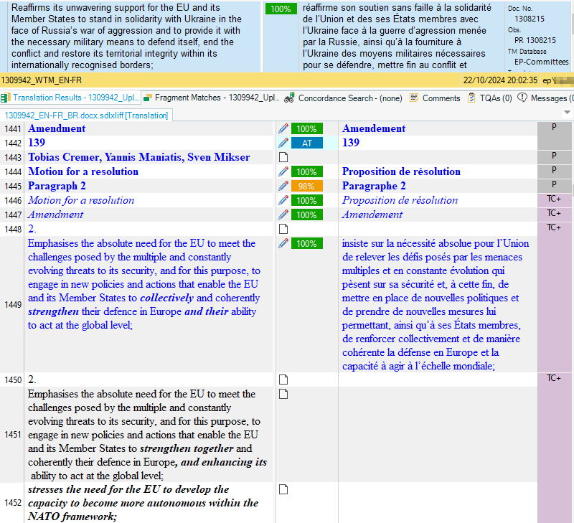
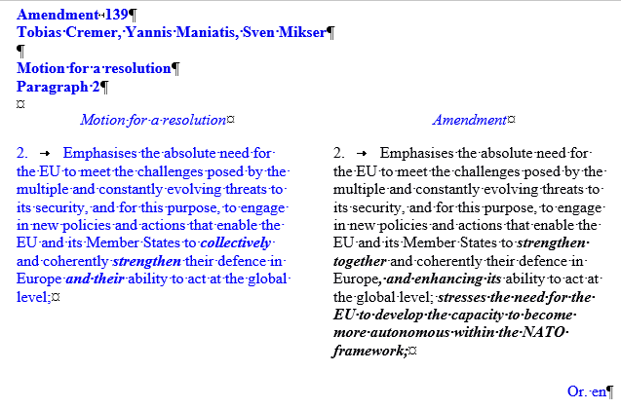
TWO-COLUMN COLOURED DOCUMENT
WORD DOCUMENT
STUDIO EDITOR

Slide 5
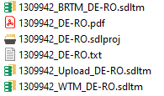
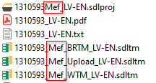
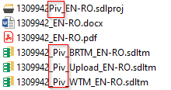
TYPES OF PRE-TREATED PACKAGES
MAIN - Original document
Pre-treated packages containing the original document sent by the requestor
MEF - Mise-en-forme
Linguistically verified original
PIV - Pivot/Relay
Relay version (EN, FR or DE) for multilingual documents containing non-pivot* languages as source
*Pivot languages: EN, FR, DE, IT, ES

Slide 6
BASIC NOTIONS
SWP –Safe working protocol
  A step-by-step guide on pre-treatment, translation and post-treatment specific to the type of document;
RETRIEVAL
  A tmx file, containing segments from up to five EP and/or interinstitutional databases with match rates higher than 65%;
PAGE COUNT
  Generated by internally developed module; based on the retrieval; calculated using a formula based on the match rate;
REFERENCES
  All other previously translated documents belonging to the procedure or indicated by the requestor as relevant to the translation of the file, in TMX format;
BR – Basic reference document
  Documents belonging to the same procedure follow a certain sequence, where each document is based on the previous one(s), called BR(s);
NORMATIVE FILES
  TMX files containing complete strings extracted from the official EP models (RDM models);

Slide 7


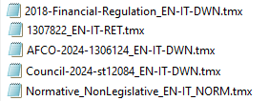
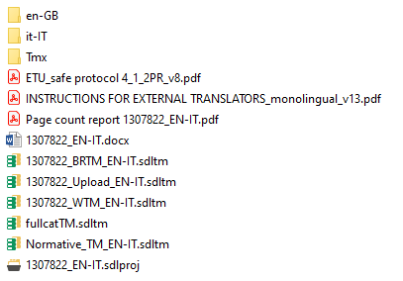
CONTENT OF A PACKAGE - monolingual Word original
Safe Working Protocol
Instructions
Page count report
Basic Reference Memory - contains the BR file
Working Memory – contains all references (retrieval + BR + other ref.)

Slide 8
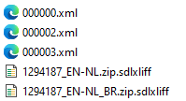
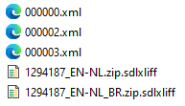
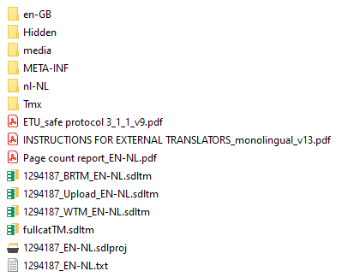

CONTENT OF A PACKAGE - monolingual XML4EP original
Safe Working Protocol
Instructions
Page count report
Basic Reference Memory - contains the BR file
Working Memory – contains all references (retrieval + BR + other ref.)

Slide 9
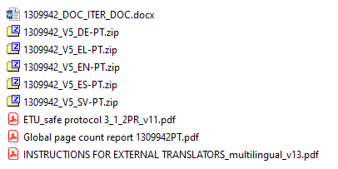
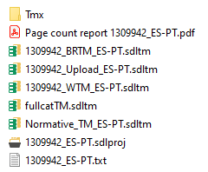
CONTENT OF A PACKAGE – multilingual document
The original is placed only in the EN-target language project folder

Slide 10
THANK YOU!

